Slide 1
HACK100
Connected Car using Apache Storm

Slide 2

Storm
Developed by BackType which was acquired by Twitter
Lots of tools for data (i.e. batch) processing
  Hadoop, Pig, HBase, Hive, …
None of them are realtime systems which is becoming a real requirement for businesses
Storm provides realtime computation
  Scalable
  Guarantees no data loss
  Extremely robust and fault-tolerant
  Programming language agnostic

Slide 3
Benefits of Apache Storm
Guaranteed data processing
Horizontal scalability
Fault-tolerance
No intermediate message brokers!
Higher level abstraction than message passing
“Just works” !!

Slide 4
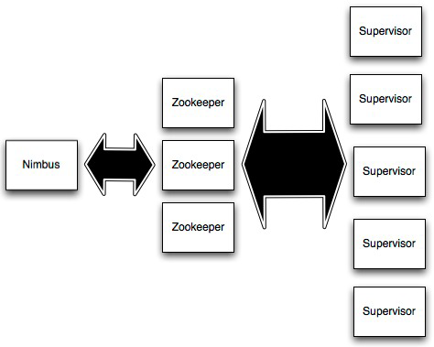
Storm Cluster
Master node (similar to
Hadoop JobTracker)
Used for cluster coordination
Run worker processes

Slide 5
Concepts
Streams
Spouts
Bolts
Topologies

Slide 6
Streams
Tuple
Tuple
Tuple
Tuple
Tuple
Tuple
Tuple
Unbounded sequence of tuples

Slide 7



Spouts
Source of streams

Slide 8



Bolts
Processes input streams and produces new streams:
Can implement functions such as filters, aggregation, join, etc

Slide 9
Topology
Network of spouts and bolts

Slide 10
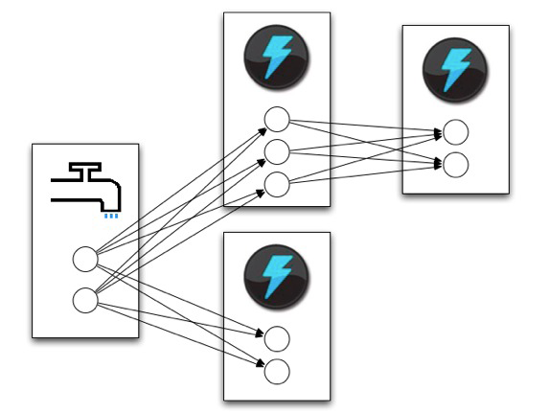
Topology
Spouts and bolts execute as
many tasks across the cluster

Slide 11
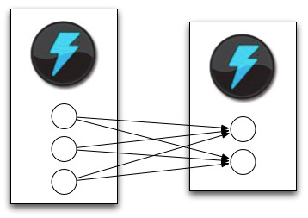
Stream Grouping
When a tuple is emitted which task does it go to?

Slide 12
Stream Grouping
Shuffle grouping: pick a random task
Fields grouping: consistent hashing on a subset of tuple fields
All grouping: send to all tasks
Global grouping: pick task with lowest id

Slide 13
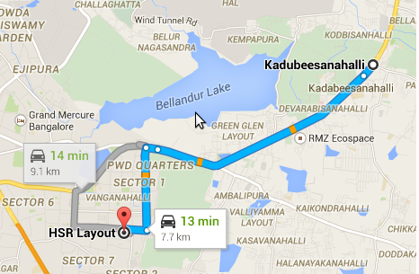
Design
Data Generation
(Latitude and
Longitude within
Route)
Bolt
Spout

Slide 15
Thank You

Slide 16

Question ?

